Slide 1
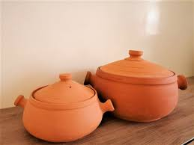
Pottery Store
Introduction to an online store offering handmade pottery items. Focus on unique and quality pottery such as plant pots, flower vases, and glasses. A simple and visually appealing design with easy navigation for users.
Pottery Ecommerce Website Design

Slide 2
Home Page Layout
Header
Includes a logo, navigation bar (Home, Products, About, Contact, Account), and cart icon.
Mobile-responsive design with a menu toggle.
Main Banner
Welcoming text: "Pottery Store: Handmade Pottery for Every Home."
Description of products and invitation to shop now.

Slide 3
Categories Section
Category 1: Pottery items like plant pots and vases.
Category 2: Decorative items for homes.
Category 3: Glassware and kitchen essentials.

Slide 4
Featured Products: Plant Pots
Product Showcase
Various sizes of plant pots: small, medium, and large.
Display of each product with price, ratings (star-based), and product image.
Example:
Plant Pot Small Size - RM6.00
Indoor Plant Pot - RM26.99

Slide 5
Featured Products: Flower Vases
Product Showcase
Different types of flower vases:
Flower Vases Small Size - RM6.00
Hanging Flower Vases - RM60.90
Flower Vases Set - RM75.00
Ratings & Pricing
Each product has star ratings and pricing details.

Slide 6
Featured Products: Glasses
Product Showcase
Display of different glass sets:
Glass Set - RM169.90
Single Glass - RM45.00
Ratings & Pricing
Each product displays star ratings and price.

Slide 7
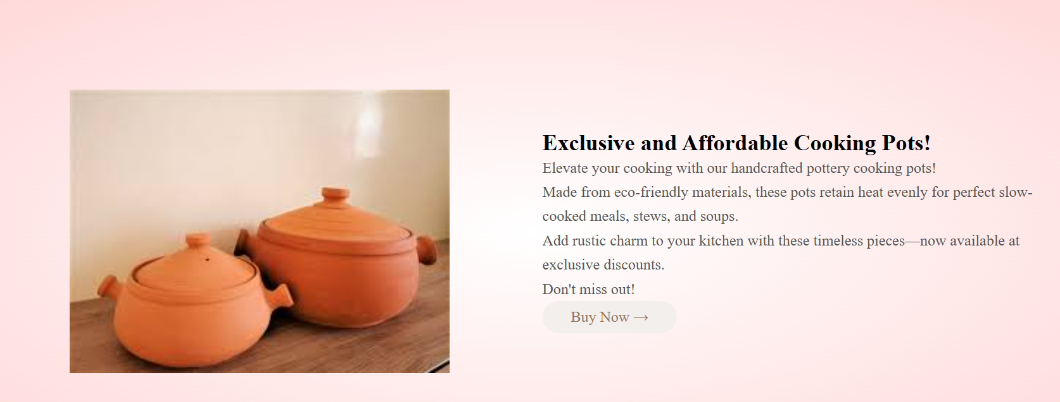
Special Offers
Exclusive Cooking Pot Sets
Description of handcrafted cooking pots with eco-friendly materials.
Aimed at enhancing cooking experiences while adding rustic charm.
Call to Action: "Buy Now" for exclusive discounts.

Slide 8
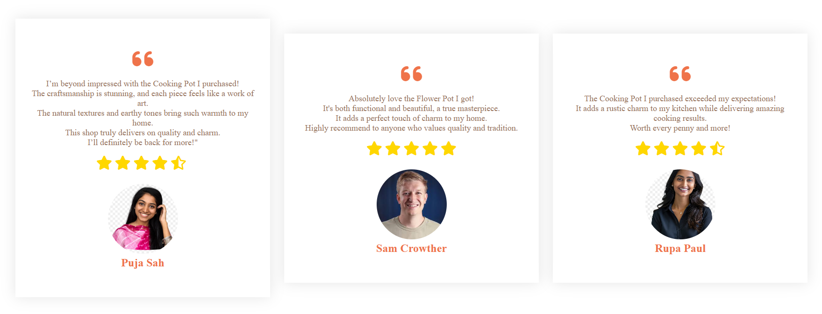
Customer Testimonials
Testimonial Section
Reviews from satisfied customers:
Puja Sah: Impressed with the cooking pot and its craftsmanship.
Sam Crowther: Loves the flower pot’s charm and functionality.
Rupa Paul: Exceeded expectations with rustic charm in the kitchen.

Slide 9
Brand Partners
Brand Showcase
Display of partner brands that collaborate with the store.
Emphasis on trusted quality brands within the pottery and ceramic industry.

Slide 10
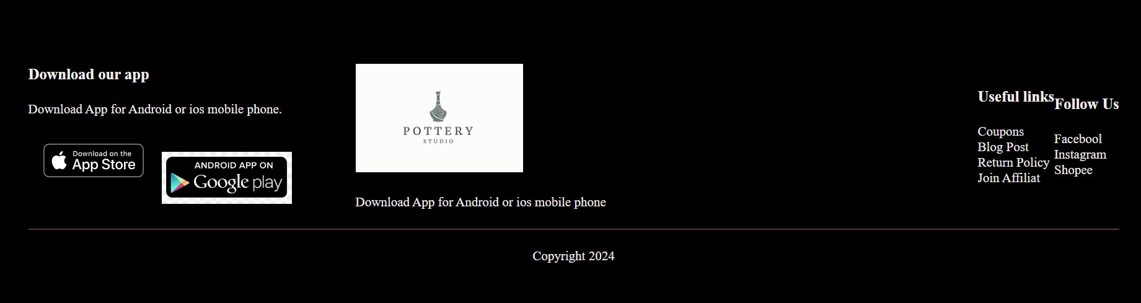

Footer Section
Footer Elements
App Download: Options for users to download the app for Android or iOS.
Brand Logo: Company branding and motto.
Useful Links: Includes coupons, blog posts, return policies, and affiliate programs.
Social Media Links: Facebook, Instagram, Shopee.

Slide 11
JavaScript Functionality
Menu Toggle Feature A JavaScript-based mobile menu toggle for easier navigation.
Explanation:
When clicked, the menu opens or closes based on the maxHeight property.

